Slide 1
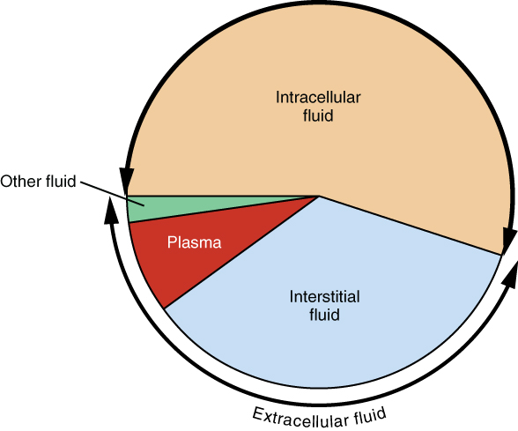
Body fluid
Definition: A natural bodily fluid or secretion of fluid such as blood, semen, or saliva Total body water, contained principally in blood plasma and in intracellular and interstitial fluids.

Slide 2
Body fluid
Types of body fluid :
1- serum (plasma)
2- breast milk
3- cerebrospinal fluid
4- lacrimal fluid
5- digestive juices
6- mucous fluid
7- salivary fluid
8- urine fluid
9- sweat fluid
10- vaginal fluid

Slide 3
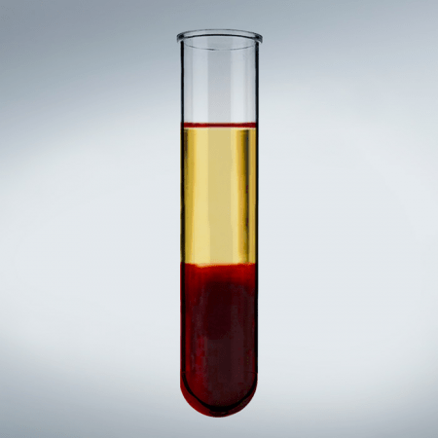
serum (plasma)
It is the component that is not considered a blood cell (blood serum does not contain white or red blood cells) . Functionally, serum is a necessary factor in the self-renewal of fetal stem cells in combination with the leukemia inhibitory factor. It is also used for diagnostic or therapeutic purposes.

Slide 4
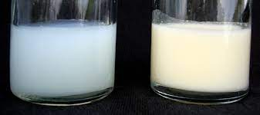
breast milk
It is the main source of nourishment for the infant before it is able to eat and digest foods and other nutrients. Breastfeeding provides health benefits to the mother. It helps the uterus return to its normal size, reduces bleeding, and also helps the mother return to her pre-pregnancy weight. Breastfeeding also reduces the risk of breast cancer. It also reduces the incidence of some types of cancer, such as childhood leukemia, as it reduces the risk of diabetes, the risk of asthma and eczema in childhood and also reduces dental problems
Cow milk
Human milk

Slide 5
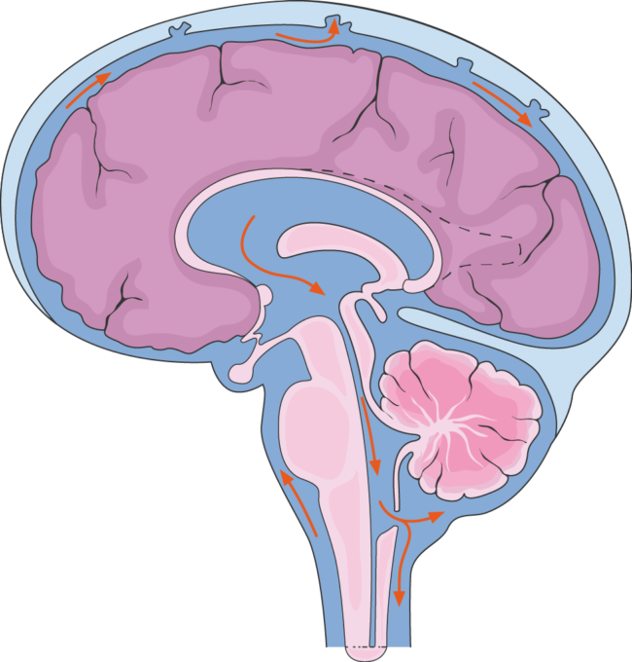
cerebrospinal fluid
It is a clear, colorless body fluid found in the brain and spinal cord. The cerebrospinal fluid acts as a cushion or protector for the brain, providing a basic mechanical and immune protection to protect the brain inside the skull, and cerebrospinal fluid plays a vital role in cerebral self-regulation of cerebral blood flow

Slide 6
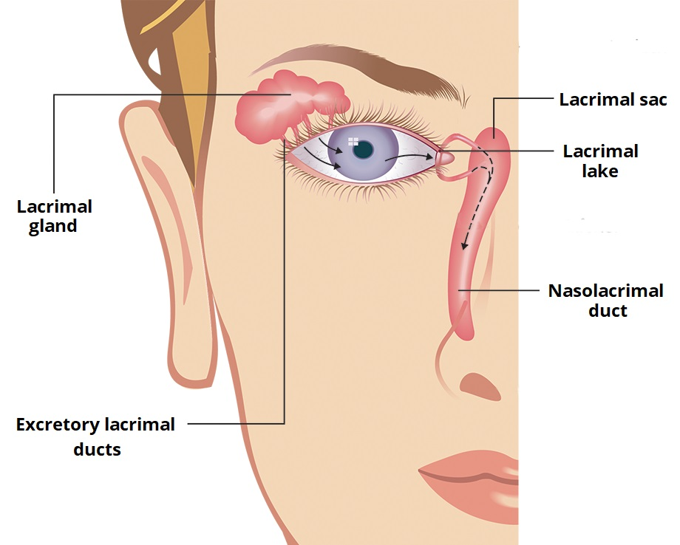
lacrimal fluid
It is a liquid resulting from the processes of production, exfoliation and shedding to clean the eye. It helps protect against germs, and it also helps to express the extent to which a person is affected in situations, as it does not indicate sadness, but rather the severity of vulnerability.

Slide 7
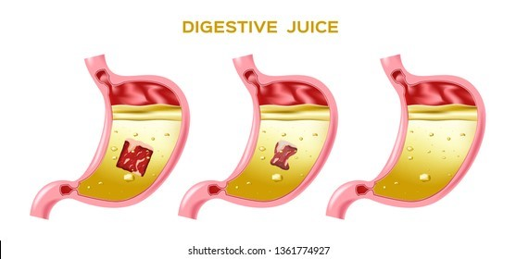
digestive juices
They are fluids secreted at the level of the digestive tube by open glands. They also consist of water, mineral salts, mucus, enzymes and acids. It breaks down the size of food pieces and proteins, and kills most of the bacteria that leak with food into the stomach, and it protects the stomach wall from HCL acid.

Slide 8
mucous fluid
It is a slippery secretion produced by the mucous membrane and covered with it that includes antiseptic enzymes. This mucus helps protect the epithelium of the respiratory tract and protects against infection from fungi and bacteria.

Slide 9
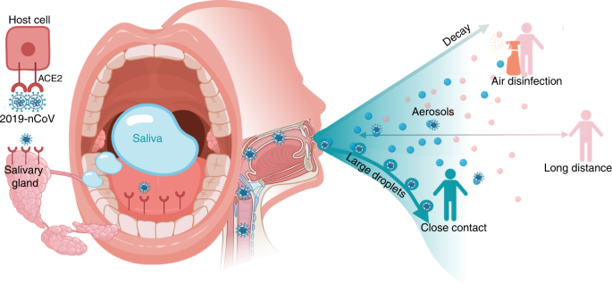
salivary fluid
It is a liquid substance that contains water, ionic compounds, viscous substances, glycoproteins, enzymes, bacterial substances, and antibacterial substances. It performs the first stage of digestion and also analyzes the parts of food that get stuck in the cracks of the teeth, which works to protect the teeth from bacterial caries. Saliva facilitates the process of swallowing and the sliding of food through the esophagus, and saliva protects the internal surfaces that cover the wall of the mouth and
prevents it from drying out.

Slide 10
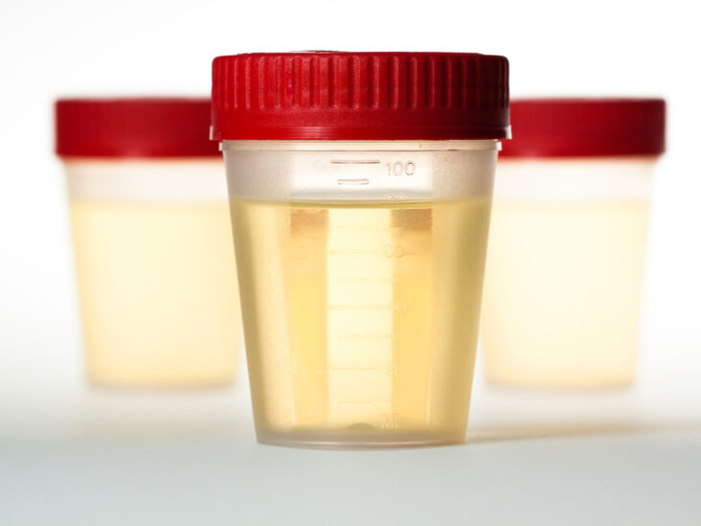
urine fluid
It is the fluid that the kidneys extract from the blood and then excrete through the ureters to reach the bladder. Urine is used to diagnose some diseases.

Slide 11
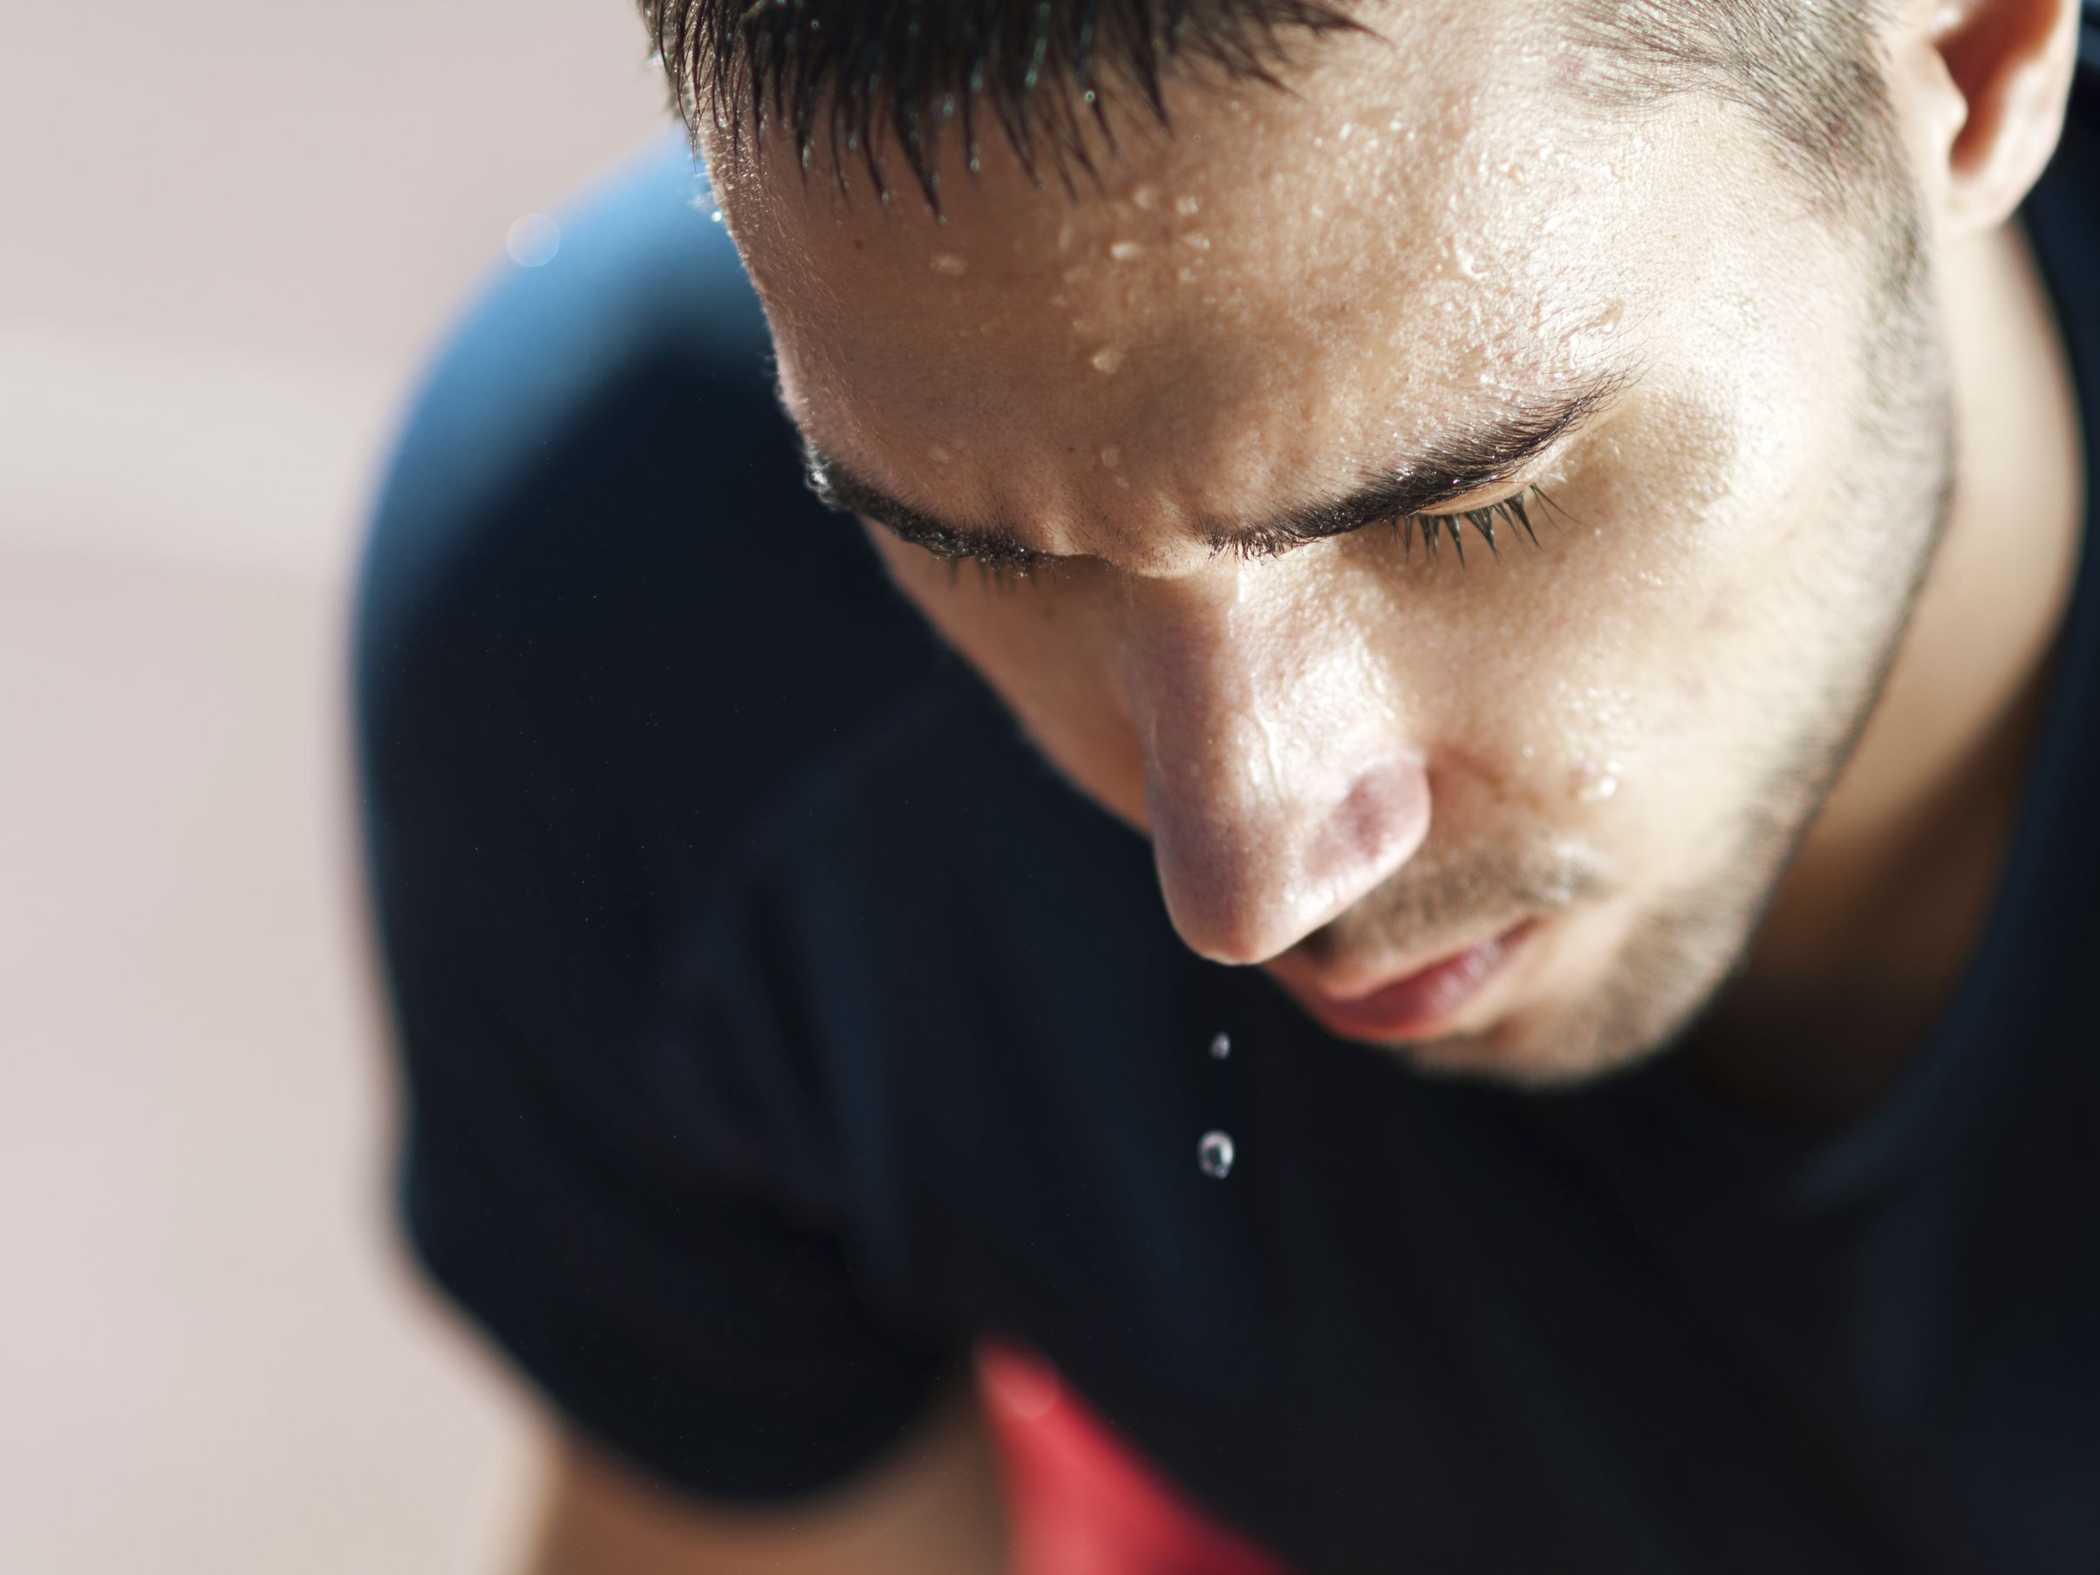
sweat fluid
It is a bodily secretion consisting mainly of water and some salts and chemical compounds. It is an acidic substance with a pH between 4 and 6. It regulates body temperature, and sweating helps improve breathing.

Slide 12
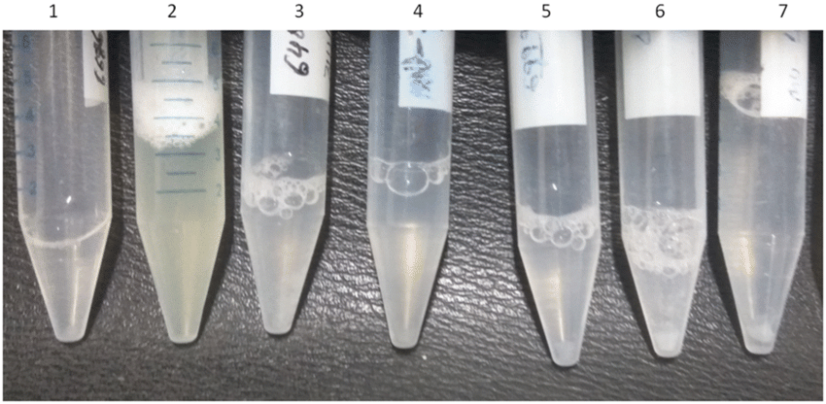
vaginal fluid
It is a natural liquid that is secreted to moisturize the vagina. The liquid also contains water, pyridine, scalene, urea, acetic acid, lactic acid, alcohol and glycol compounds, ketones, and aldehydes.

Slide 13
Functions
•Major component of blood plasma Maintains the overall function of the body
•Essential for metabolism and supporting the cellular metabolism
•molecular transport, such gases transport
•Help to generate the electrical activity needed to power body functions biochemical reactions,
•Regulation body temperature
•Lubricant joints and moistest tissue
•Solvent for nutrients and waste products
•Provides some mineral elements

Slide 14
disease
Diseases affecting body fluid Health care workers have serious concerns about exposure to bodily fluids. Accidental exposures to bodily fluids present a wide variety of issues to healthcare workers. These issues include transmission of communicable diseases such as human immune deficiency virus (HIV), hepatitis B virus (HBV), and hepatitis C virus (HCV). These exposures have led to a significant public health hazard since they have become a known occupational hazard in 1978. Among healthcare workers, nursing staff/students seem to have the highest rate of exposures at 45%, and providers come next at 17%

Slide 15
References
1. Boundless Anatomy and Physiology
2. Bookshelf home
3. dictionary

Slide 16
615 Fathi Rebhi Raddad
608 Adnan Ahmad Qaddura
605 Abdullah Abd-alrahman hleis
606 Abdullah labib Abdullah
607 Othman Khaled dar
609 Adi Ammar Shahine
611 Amro Fareh Saluman
613 Amro Fuad Ghanem
614 Fares Abd-almlik Adlan
612 Amro Abd-Alkarem Awwad

